Slide 1
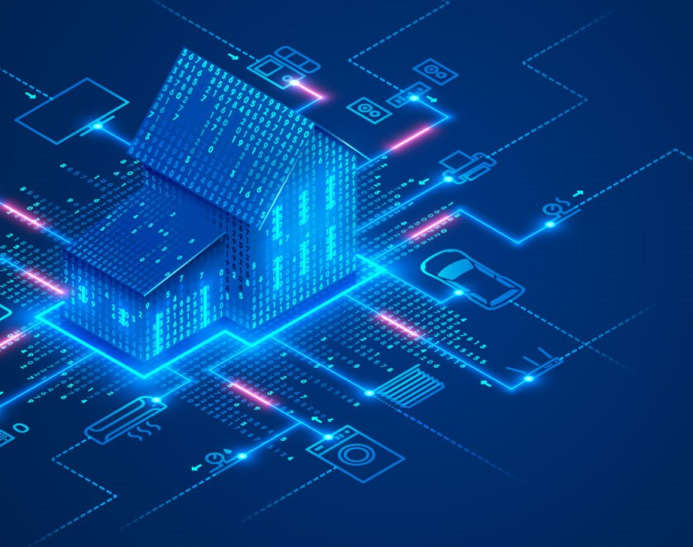
Smart Home System
Prepared By:
Tasawar Siddiquy Asm Nurussafa

Slide 2
Topics to discuss:
Introduction to Smart Homes: Pros and Cons.
Ideas and scenario explanations using Activity and Sequence diagrams.
Smart Window scenario implementation- C++ implementation and μC implementation.
Smart Lighting System implementation- C++ implementation and μC implementation.

Slide 3

What Does Smart Home Mean?
Smart Home System or Artificial Intelligent Homes means automation and control of the electrical appliance with Artificial Intelligent. It can also be remotely controlled by electronic devices[1].

Slide 4
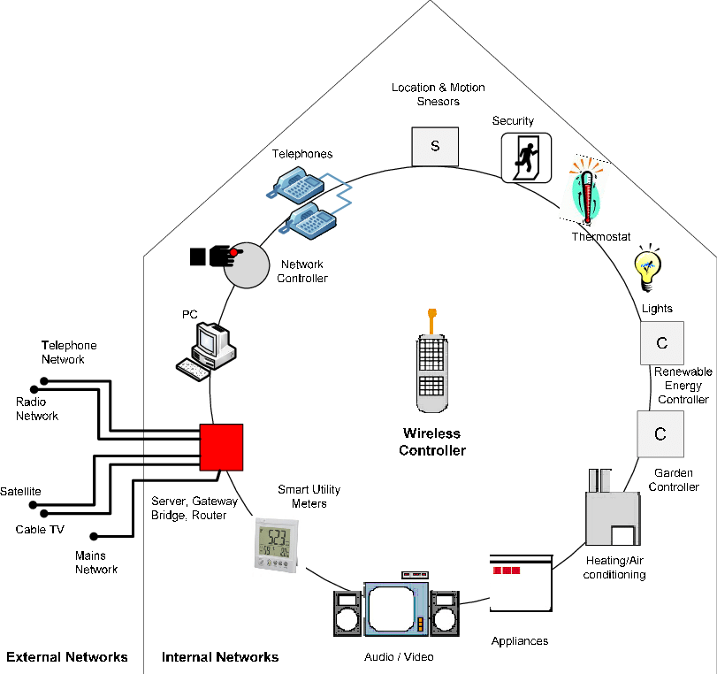
Architectural Overview
Al-Qutayri, Mahmoud & Jeedella, Jeedella. (2010). Integrated Wireless Technologies for Smart Homes Applications. 10.5772/8412.

Slide 5
Disadvantages
Significant installation costs
Unreliable internet connection
Cyber Threat
Technological problems in connected homes
You may lock yourself out of your own house
Helplessness if technology fails
Some people may not like smart technologies
Compatibility problems between devices

Slide 6
Advantages
Managing all of your home devices from one place
Flexibility for new devices and appliances
Maximizing home security
Remote control of home functions with smartphone or other devices
Increased energy efficiency
Improved appliance functionality
Home management insights

Slide 7
Ideas & Scenarios

Slide 8
Smart Gardening:
A separate space for garden in the house for the plant lovers. The smart home will allow devices like GreenSens to be compatible with it, keeping the user constantly updated about the health of each of the plants in the garden.
Requirements: GreenSens, Space in the house.

Slide 9
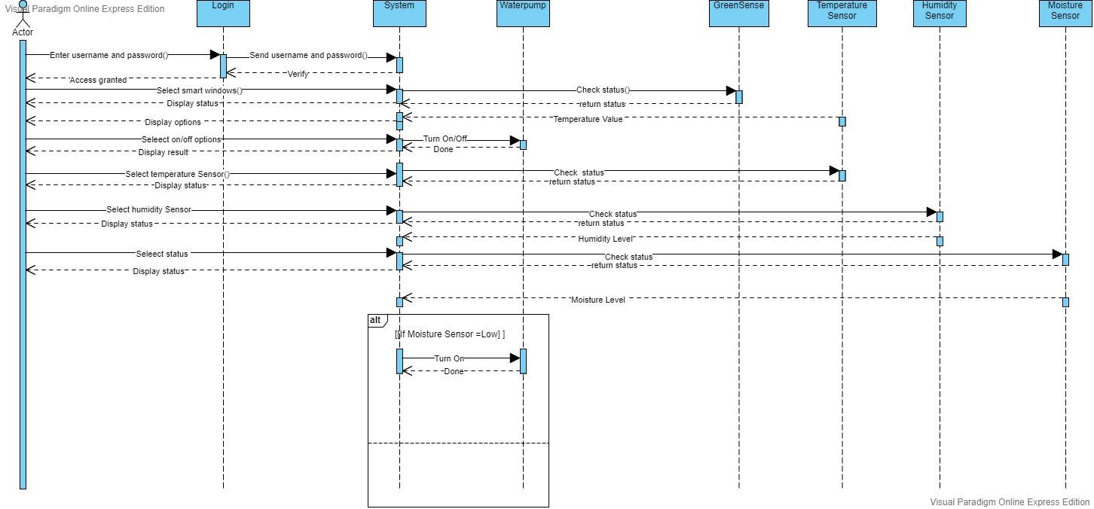
Sequence Diagram

Slide 10
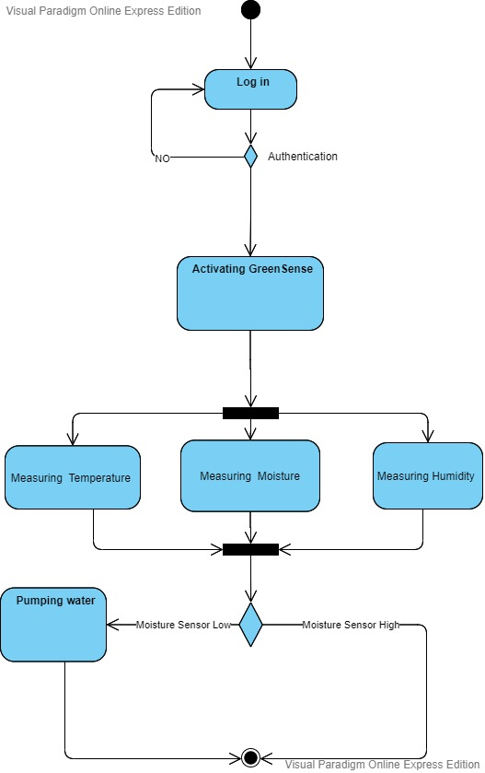
Activity Diagram

Slide 11
Gas Leakage:
Generally in our region, we are highly dependent on gas-controlled stoves. This is, indeed, very dangerous. To make a safer environment in the house, our smart home will include a gas leakage system. This system will generally keep track of gas level in the kitchen vicinity. Once the gas level in the kitchen is more than usual, or out of control, the system will take precautionary measures, such as an alarm system will go off, shutting off the gas flow and on user preference, the windows might open.
Requirements: Gas sensor, alarm system, Micro-controller.

Slide 12
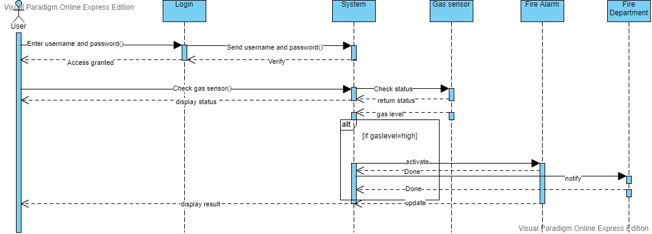
Sequence Diagram

Slide 13
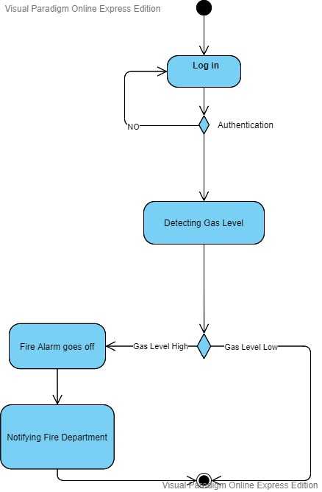
Activity Diagram

Slide 14
Rain water-recycling system:
Luckily, our region has rainy seasons. While this is a real problem, but can also be used to our benefits. Our smart home can store the excess rain water by strategical planning throughout the house, and recycle them; e.g. by purifiying the water or use them in the smart gardening system.
Requirements: Water reservoirs, filter system, water-pumps.

Slide 15
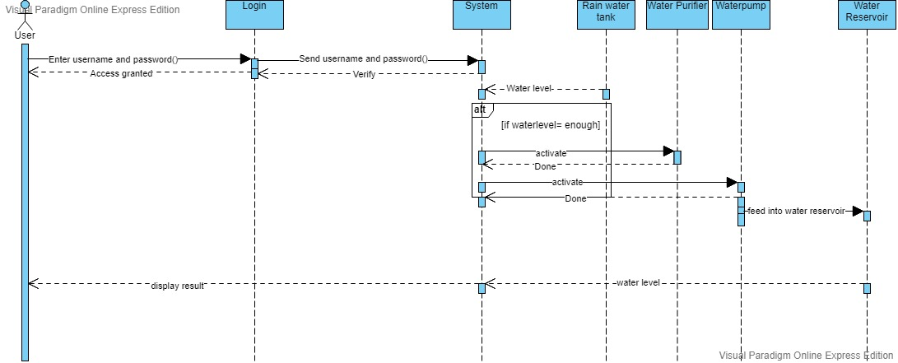
Sequence Diagram

Slide 16
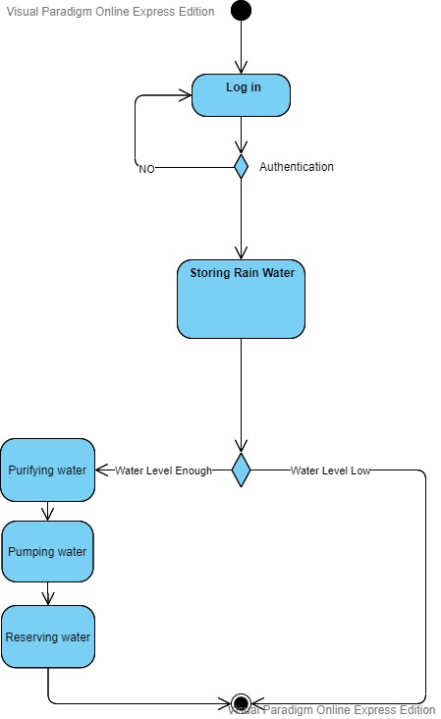
Activity Diagram

Slide 17
Insect Repellers:
Our region is also very prone to insects, especially mosquitoes. Our smart home will include a central system to kill insects, or drive them away. This can be controlled by activating some insect-repelling devices and closing the windows at specific times of a day to keep the insects at bay.
Requirements: Ultrasonic pest repellent.

Slide 18
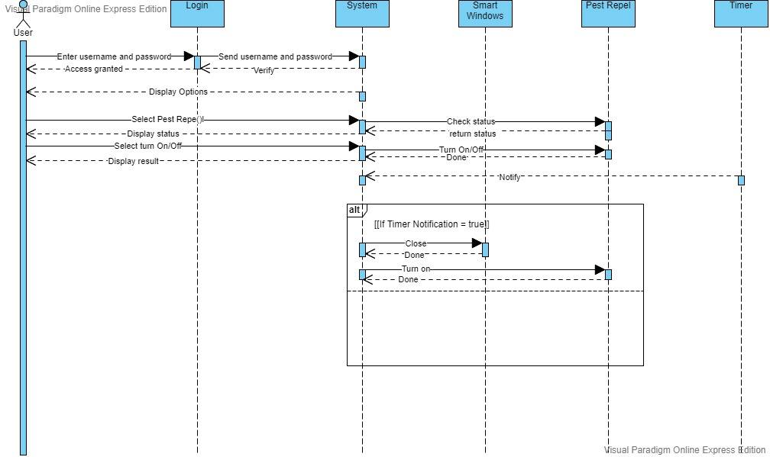
Sequence Diagram

Slide 19
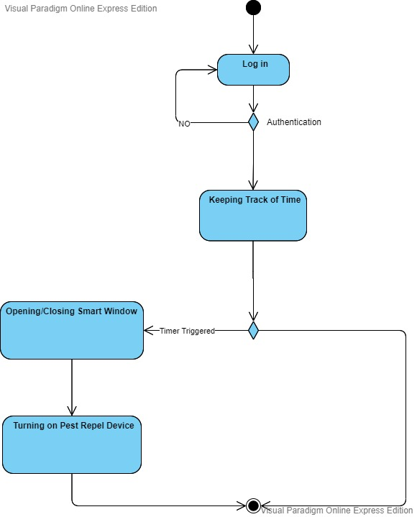
Activity Diagram

Slide 20
Lightning Rods:
Lightnings are a common phenomenon in our region. In fact, very few houses have precautions to this. So as a precaution, we can use lightning rods to direct the lightning to the ground. So, the smart system can activate the lightning rod, when it can foresee thunderstorms. Requirements: Smart ESE lightning rod (ESE28)

Slide 21
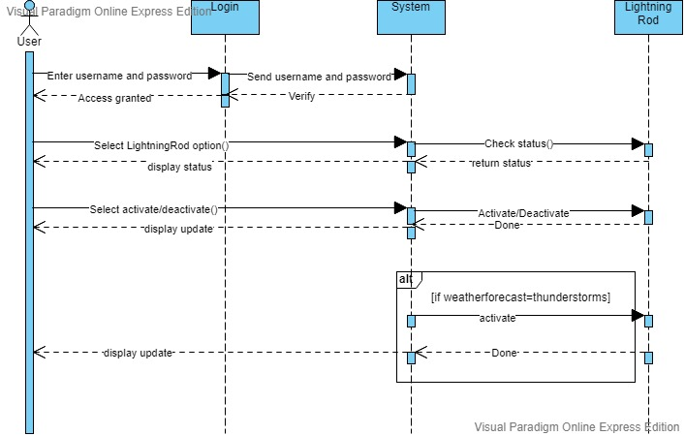
Sequence Diagram

Slide 22
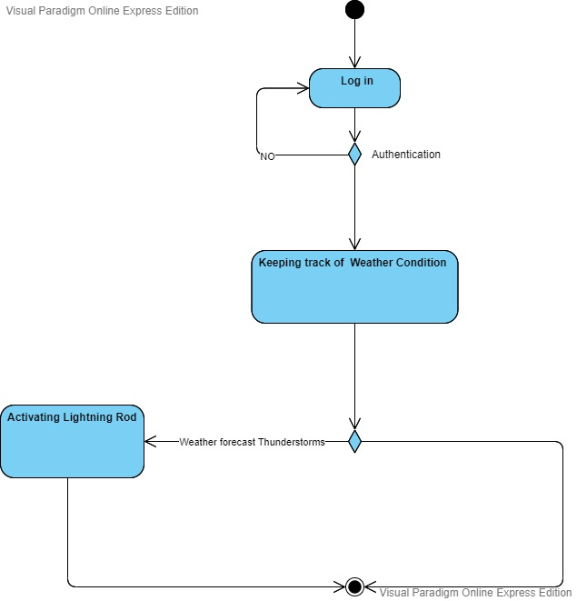
Activity Diagram

Slide 23
Class Diagram For Smart Home System

Slide 24
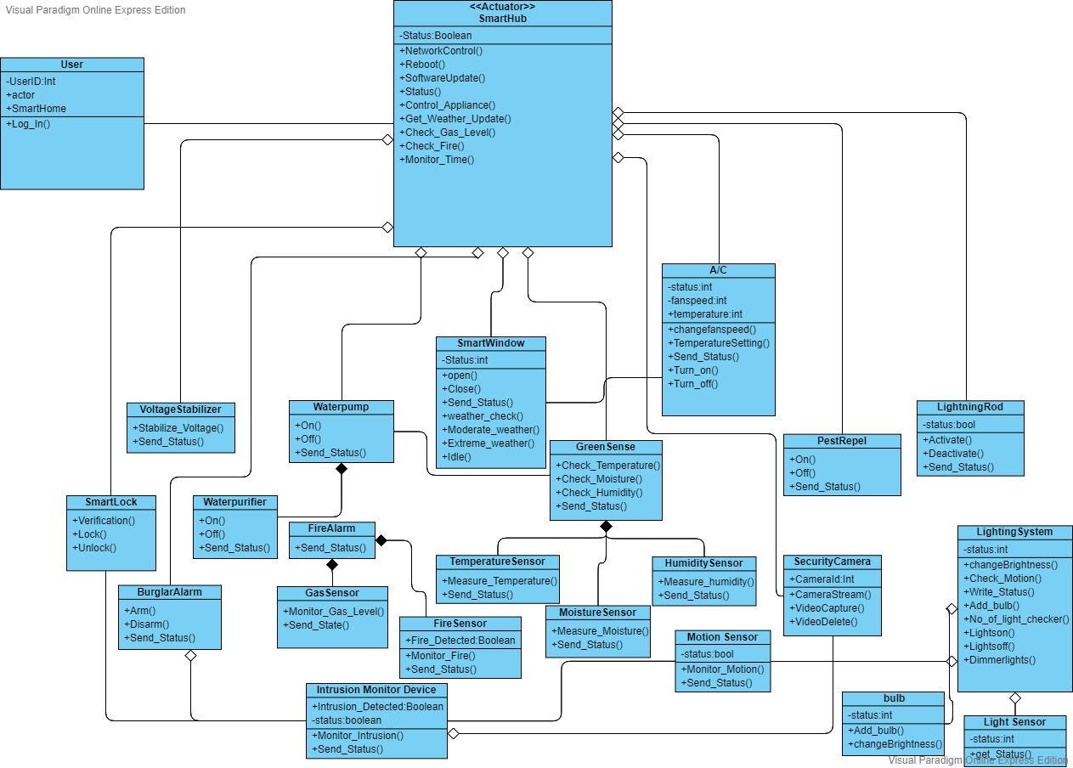

Slide 25
Use-Case Diagram For Smart Home System

Slide 26
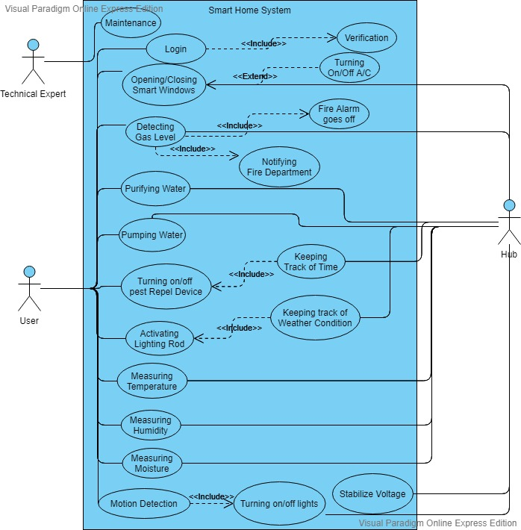

Slide 27
Smart Windows:
Smart windows will be automatically closed in case of extreme weather or rain. This is can be user-preference based, the user can set a temperature; depending on which the AC or heater will be automatically activated/ deactivated.
Requirements : Windows, Micro-controller, AC, Wifi.

Slide 28
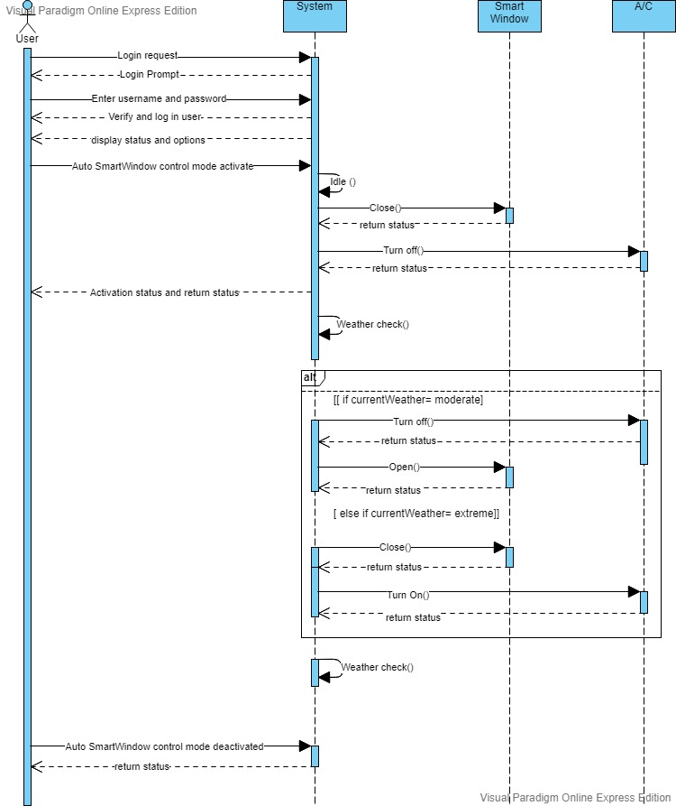
Sequence Diagram

Slide 29
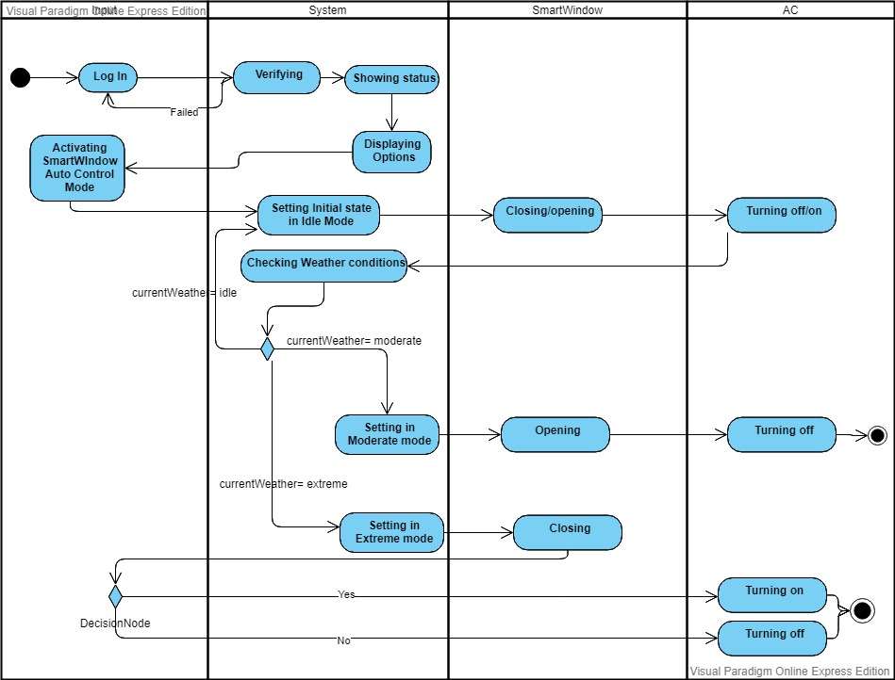
Activity Diagram

Slide 30
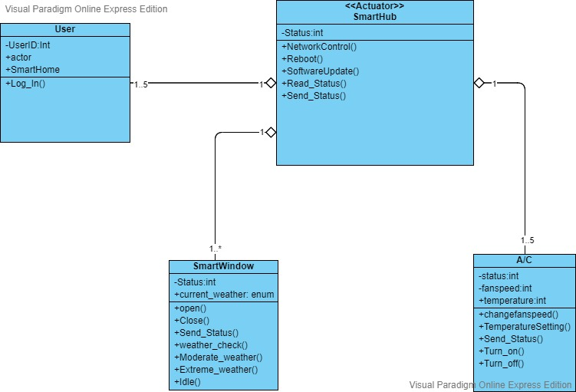
Class Diagram

Slide 31
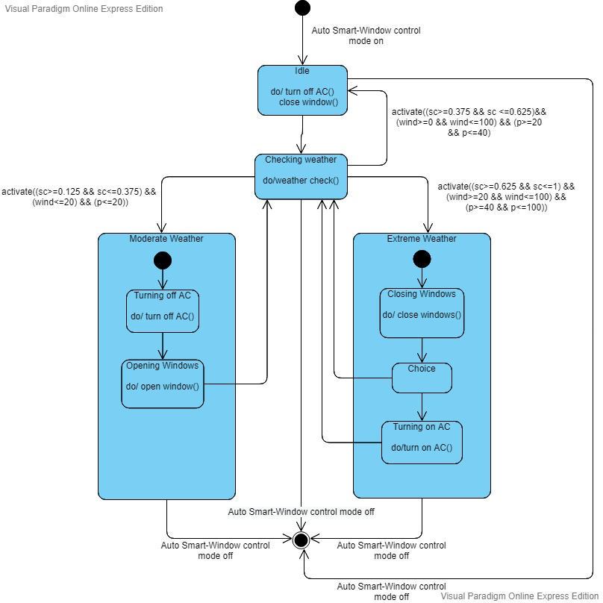
State-Machine Diagram

Slide 32
Smart Lighting System
Electricity shortage is a big problem in our Country. But by installing this Smart Lighting System can save a lot of electricity. It will always check for the motion so if anyone forgets to turn off the lights it can automatically detect that and will take action automatically.
Requirements: Motion sensor, Light intensity sensor, Smarthub(Micro-controller).

Slide 33
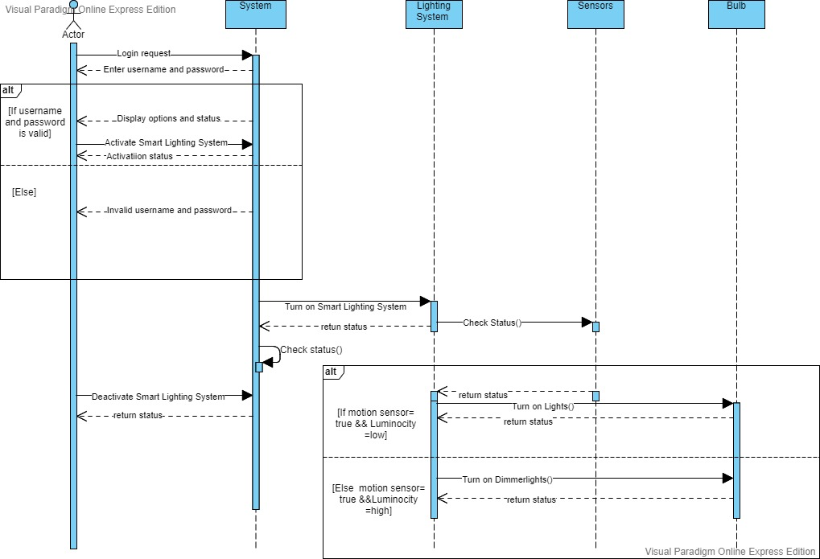
Sequence Diagram

Slide 34
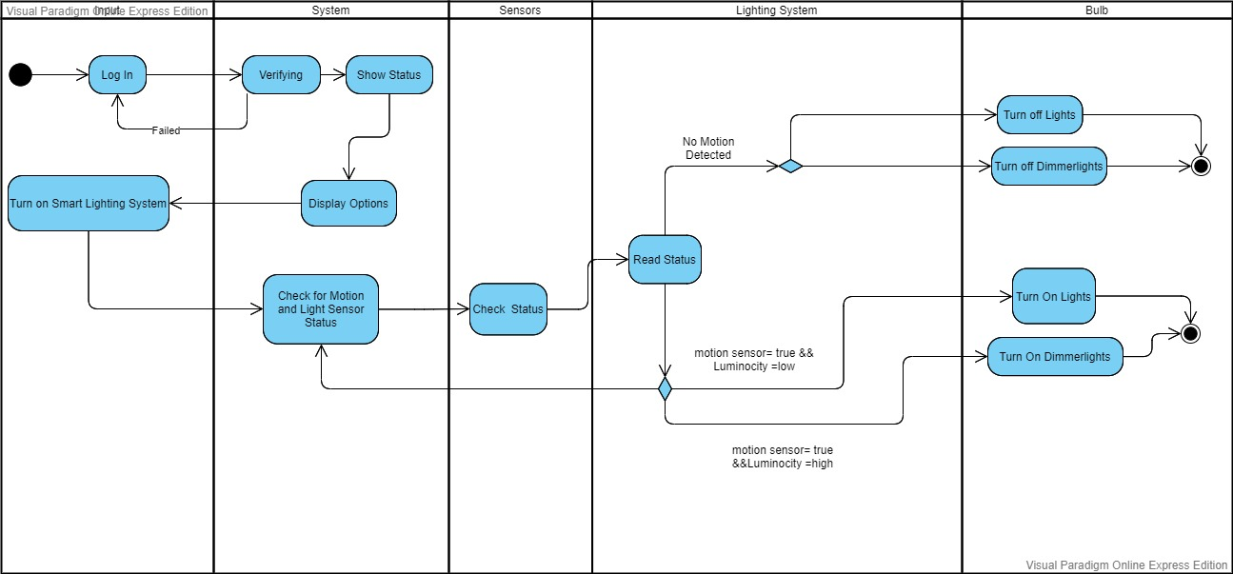
Activity Diagram

Slide 35
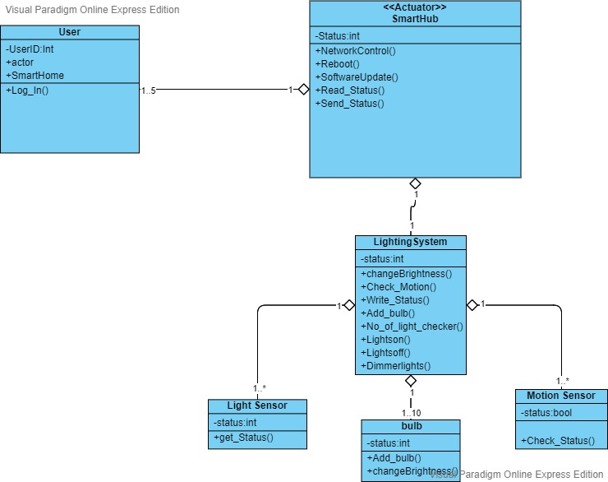
Class Diagram

Slide 36
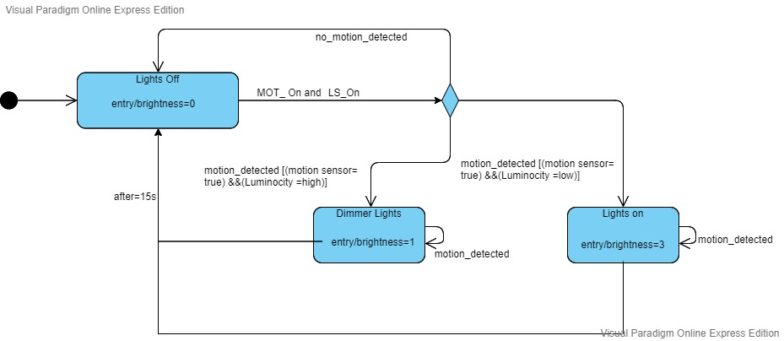
State Machine Diagram

Slide 37
Thank you!
Have any questions?

Slide 38
References

